Slide 1


Surya D
14-09-2024

Slide 2

Outline
Executive Summary
Introduction
Methodology
Results
Conclusion
Appendix

Slide 3
Executive Summary
Summary of methodologies
Summary of all results
Summary of Methodologies:
Data Preprocessing: Standardized features and split data into training (80%) and testing (20%) sets.
Model Training: Used GridSearchCV for hyperparameter tuning and cross-validation for four models: Logistic Regression, SVM, Decision Tree, and KNN.
Evaluation: Tested models for accuracy and analyzed confusion matrices.
Summary of Results:
Logistic Regression: Best accuracy – 83.33%.
SVM (linear kernel): Best accuracy – 83.33%.
Decision Tree: Lower accuracy – 73.33%.
KNN: Accuracy – 77%.

Slide 4
Introduction
Project background and context
Problems you want to find answers
Project Background and Context:
SpaceX's Falcon 9 rocket reusability reduces launch costs significantly. This project aims to predict whether the first stage will land successfully, using historical SpaceX launch data, including factors like launch site, payload mass, and orbit type.
Problems You Want to Find Answers To:
Can we predict the Falcon 9 first stage landing success?
Which factors influence landing success (e.g., payload mass, launch site)?
Which model (Logistic Regression, SVM, etc.) performs best?
What are the best hyperparameters for each model?

Slide 5

Section 1

Slide 6
Methodology
Executive Summary
Data collection methodology:
Data was collected using web scarping.
Perform data wrangling
Exploratory Data Analysis to find some patterns in the data and determine what would be the label for training supervised models.
Perform exploratory data analysis (EDA) using visualization and SQL
Exploratory Data Analysis using python library (Matplotlib, Seaborn) and using SQL. Feature Engineering
Perform interactive visual analytics using Folium and Plotly Dash
Use Folium to view previously observed correlations.
Perform predictive analysis using classification models
Creating machine learning models to predict if the firtst stage will land.

Slide 7
Data Collection
Describe how data sets were collected.
You need to present your data collection process use key phrases and flowcharts
Data Collection Process (in Short):
SpaceX API: Data on Falcon 9 launches (e.g., launch site, payload mass, orbit, landing success) was fetched from the SpaceX API.
Geographic Data: Latitude and longitude of launch sites were added to the dataset for location analysis.
Data Cleaning: The raw data was cleaned and formatted for consistency.
Combined Dataset: Data from multiple sources (API + geographic) was merged to form a complete dataset.
SPACEX API
DATA CLEANING
GEOGRAPHIC DATA
FINAL DATASET

Slide 8
Data Collection – SpaceX API
Github link: https://github.com/CmeDinfinity/Capstone_spaxeX/blob/main/Data%20Collection%20API.ipynb
SpaceX REST API
GET /launches (Launch Details) Provides launch site, date, success
GET /rockets (Rocket Info) Provides details about the rocket
GET /payloads (Payload Info) Provides mass and orbit type
GET /launchpads (Geographic Info) Provides latitude and longitude
Aggregated Dataset
Final cleaned and combined data

Slide 9
Data Collection - Scraping
Github link :
https://github.com/CmeDinfinity/Capstone_spaxeX/blob/main/Data%20Collection%20with%20Web%20Scraping.ipynb
Identify Target Website
Send HTTP Request
(using requests)
Parse HTML
(using BeautifulSoup)
Extract Data
(from HTML elements)
Clean and Structure Data
Store Data (in DataFrame or CSV)

Slide 10
Data Wrangling
Load Data: Load data from APIs and web scraping into a DataFrame.
Handle Missing Data: Identify and fill or remove missing values.
Clean Data: Remove unnecessary columns and correct data types.
Feature Engineering: Create new features, such as one-hot encoding for categorical variables.
Standardization: Scale numerical data using StandardScaler.
Data Integration: Merge data from multiple sources into a cohesive dataset.
GitHub : https://github.com/CmeDinfinity/Capstone_spaxeX/blob/main/Data%20Wrangling.ipynb
Load Data (API/Web Scraping)
Identify and Handle Missing Data
Data Cleaning (Remove Noise)
Feature Engineering (One-Hot)
Standardize Data (Numerical)
Data Integration (Merge Sources)
Final Dataset Ready

Slide 11
EDA with Data Visualization
Scatter Plot (Flight Number vs. Launch Site): Show landing success based on flight number and launch site.
Scatter Plot (Payload vs. Launch Site): Analyze how payload mass affects landing success at each site.
Bar Plot (Success Rate per Orbit Type): Visualize success rate for each orbit type.
Line Chart (Launch Success Trend by Year): Track yearly trends in landing success.
Confusion Matrix: Evaluate model performance by showing true/false positives and negatives.
Github:
https://github.com/CmeDinfinity/Capstone_spaxeX/blob/main/EDA%20with%20Data%20Visualization.ipynb

Slide 12
EDA with SQL
Retrieve Unique Launch Sites:
sql
SELECT DISTINCT Launch_Site FROM SPACEXTBL;
Records Where Launch Site Starts with 'CCA':
sql
SELECT * FROM SPACEXTBL WHERE Launch_Site LIKE 'CCA%';
Total Payload Mass by NASA (CRS) Launches:
sql
SELECT SUM(Payload_Mass__kg_) FROM SPACEXTBL WHERE Customer = 'NASA (CRS)';
Average Payload Mass for Falcon 9 v1.1:
sql
SELECT AVG(Payload_Mass__kg_) FROM SPACEXTBL WHERE Booster_Version = 'F9 v1.1';
Date of First Successful Ground Pad Landing:
sql
SELECT MIN(Date) FROM SPACEXTBL WHERE Landing_Outcome = 'Success (ground pad)';
Boosters with Drone Ship Success and Payload Mass 4000-6000 kg:
sql
SELECT Booster_Version FROM SPACEXTBL WHERE Landing_Outcome = 'Success (drone ship)' AND Payload_Mass__kg_ BETWEEN 4000 AND 6000;
Total Successful and Failed Missions:
sql
SELECT Landing_Outcome, COUNT(*) FROM SPACEXTBL GROUP BY Landing_Outcome;
Booster Versions with Maximum Payload Mass:
sql
SELECT Booster_Version FROM SPACEXTBL WHERE Payload_Mass__kg_ = (SELECT MAX(Payload_Mass__kg_) FROM SPACEXTBL);
Failed Drone Ship Landings in 2015 by Month:
sql
SELECT SUBSTR(Date, 6, 2) AS Month, Booster_Version, Launch_Site, Landing_Outcome FROM SPACEXTBL WHERE Landing_Outcome = 'Failure (drone ship)' AND SUBSTR(Date, 1, 4) = '2015';
Rank Landing Outcomes (2010-06-04 to 2017-03-20):
sql
SELECT Landing_Outcome, COUNT(*) AS Outcome_Count FROM SPACEXTBL WHERE Date BETWEEN '2010-06-04' AND '2017-03-20' GROUP BY Landing_Outcome ORDER BY Outcome_Count DESC;
GITHUB: https://github.com/CmeDinfinity/Capstone_spaxeX/blob/main/EDA_sql.ipynb

Slide 13
Build an Interactive Map with Folium
Map Objects Added to Folium Map:
Markers: Added to each launch site to pinpoint locations.
Circles: Highlighted the area around each launch site.
Marker Clusters: Grouped multiple launches at the same site to reduce clutter.
Color-Coded Markers: Green for successful landings, red for failed landings.
Polylines: Showed distances from launch sites to nearby landmarks (e.g., coastlines, cities).
Why:
To clearly visualize launch sites, landing outcomes, and their proximity to important geographic features.
GITHUB: https://github.com/CmeDinfinity/Capstone_spaxeX/blob/main/Interactive%20Visual%20Analytics%20with%20Folium%20lab.ipynb

Slide 14
Build a Dashboard with Plotly Dash
Plots/Graphs and Interactions Added to the Dashboard:
Line Plot: Shows launch success over time.
Bar Chart: Displays success rate by orbit type.
Scatter Plot: Visualizes flight number vs. payload mass vs. success.
Map: Interactive map of launch sites and outcomes.
Dropdown Filter: Allows users to filter data by launch site.
Tooltips/Hover: Provides quick data insights on hover.
Why:
To visualize trends, compare success rates, and enable interactive data exploration for deeper insights.
GITHUB: https://github.com/CmeDinfinity/Capstone_spaxeX/blob/main/spacex_dash_app.py

Slide 15
Predictive Analysis (Classification)
Load Data
Built Models: Created Logistic Regression, SVM, Decision Tree, and KNN models.
Evaluated Models: Used accuracy and confusion matrices for performance evaluation.
Improved Models: Tuned hyperparameters using GridSearchCV and standardized data.
Best Model: SVM (linear) and Logistic Regression performed best with 83.33% accuracy.
Preprocess (Standardize, Split)
Build Models (Logistic, SVM, etc.)
Tune Hyperparameters (GridSearchCV)
Evaluate (Accuracy, Confusion Matrix)
Compare Models
GITHUB: https://github.com/CmeDinfinity/Capstone_spaxeX/blob/main/Machine%20Learning%20Prediction.ipynb
Select Best Model (SVM, Logistic Regression)

Slide 16
Results
Exploratory data analysis results:
•Space X uses 4 different launch sites;
•The first launches were done to Space X itself and NASA;
•The average payload of F9 v1.1 booster is 2,928 kg;
•The first success landing outcome happened in 2015 fiver year after the first launch;
•Many Falcon 9 booster versions were successful at landing in drone ships having payload above the average;
•Almost 100% of mission outcomes were successful;
•Two booster versions failed at landing in drone ships in 2015: F9 v1.1 B1012 and F9 v1.1 B1015;
•The number of landing outcomes became as better as years passed.

Slide 17
Results
•Using interactive analytics was possible to identify that launch sites use to be in safety places, near sea, for example and have a good logistic infrastructure around.
•Most launches happens at east cost launch sites.

Slide 18
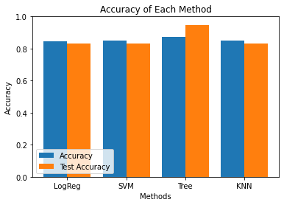
Results
•Predictive Analysis showed that Decision Tree Classifier is the best model to predict successful landings, having accuracy over 87% and accuracy for test data over 94%.

Slide 19

Section 2

Slide 20
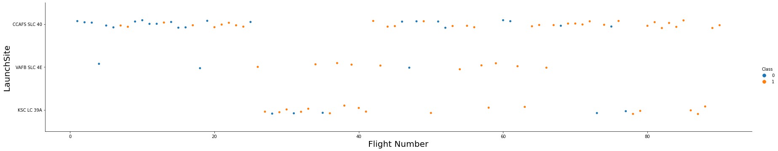
Flight Number vs. Launch Site
CCAFS SLC 40 is the best-performing launch site, with most recent launches being successful.
VAFB SLC 4E ranks second in launch success.
KSC LC 39A holds the third position in launch success.
The overall success rate has steadily improved over time.

Slide 21
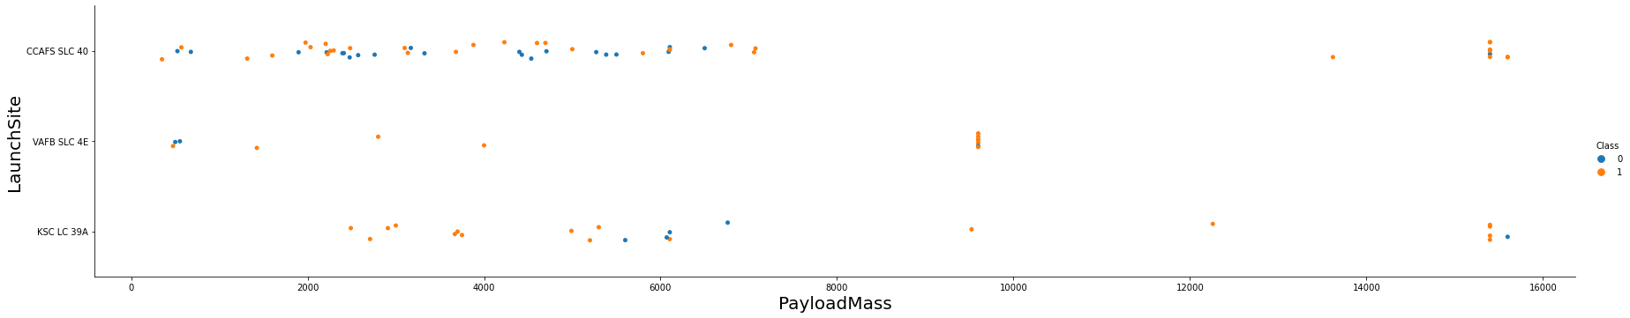
Payload vs. Launch Site
Payloads exceeding 9,000kg (approximately the weight of a school bus) have a high success rate.
Payloads over 12,000kg appear to be launched exclusively from the CCAFS SLC 40 and KSC LC 39A sites.

Slide 22
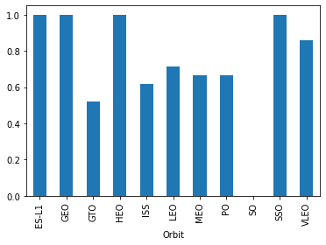
Success Rate vs. Orbit Type
The highest success rates are observed in the following orbits:
ES-L1
GEO
HEO
SSO
This is followed by:
VLEO with a success rate of over 80%
LFO with a success rate of over 70%

Slide 23
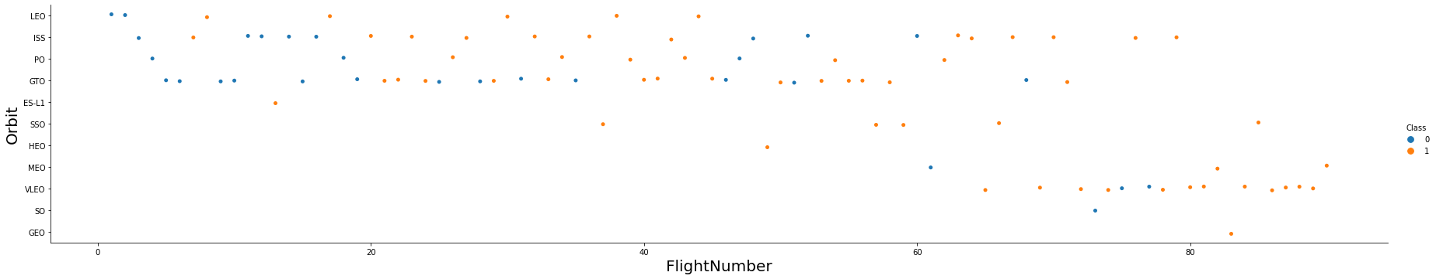
Flight Number vs. Orbit Type
The success rate has improved over time across all orbits.
The VLEO orbit presents a new business opportunity, as its frequency has recently increased.

Slide 24
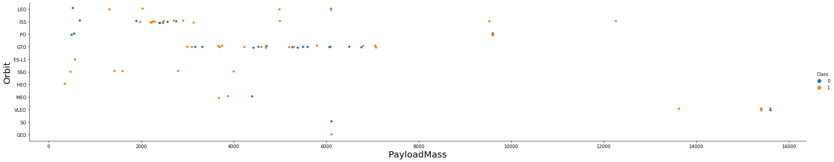
Payload vs. Orbit Type
There appears to be no correlation between payload size and success rate for the GTO orbit.
The ISS orbit handles the widest range of payloads and maintains a good success rate.
There are relatively few launches to the SO and GEO orbits.

Slide 25
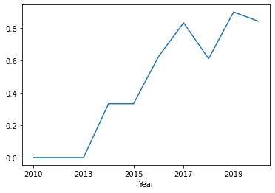
Launch Success Yearly Trend
The success rate began increasing in 2013 and continued to improve until 2020.
The first three years appear to have been a period of adjustments and technological improvements.

Slide 26
All Launch Site Names
Launch Site Names:
Launch Site
CCAFS LC-40
CCAFS SLC-40
KSC LC-39A
VAFB SLC-4E

Slide 27
Launch Site Names Begin with 'CCA'
5 records where launch sites begin with `CCA`
Date | Time UTC | Booster Version | Launch Site | Payload | Payload Mass kg | Orbit | Customer | Mission Outcome | Landing Outcome
2010-06-04 | 18:45:00 | F9 v1.0 B0003 | CCAFS LC-40 | Dragon Spacecraft Qualification Unit | 0 | LEO | SpaceX | Success | Failure (parachute)
2010-12-08 | 15:43:00 | F9 v1.0 B0004 | CCAFS LC-40 | Dragon demo flight C1, two CubeSats, barrel of Brouere cheese | 0 | LEO (ISS) | NASA (COTS) NRO | Success | Failure (parachute)
2012-05-22 | 07:44:00 | F9 v1.0 B0005 | CCAFS LC-40 | Dragon demo flight C2 | 525 | LEO (ISS) | NASA (COTS) | Success | No attempt
2012-10-08 | 00:35:00 | F9 v1.0 B0006 | CCAFS LC-40 | SpaceX CRS-1 | 500 | LEO (ISS) | NASA (CRS) | Success | No attempt
2013-03-01 | 15:10:00 | F9 v1.0 B0007 | CCAFS LC-40 | SpaceX CRS-2 | 677 | LEO (ISS) | NASA (CRS) | Success | No attemp

Slide 28
Total Payload Mass
Total Payload in KG : 111.268
SELECT SUM(Payload_Mass__kg_) AS Total_Payload_Mass FROM SPACEXTBL WHERE Customer = 'NASA (CRS)';
Explanation:
Purpose: This query calculates the total payload mass carried by SpaceX boosters for NASA (Customer = 'NASA (CRS)').
SUM(): Aggregates the payload mass (Payload_Mass__kg_) for all launches where NASA was the customer.
WHERE clause filters the records to only include those for NASA's Cargo Resupply Services (CRS) missions.

Slide 29
Average Payload Mass by F9 v1.1
The average payload mass carried by booster version F9 v1.1 is 2928 KG

Slide 30
First Successful Ground Landing Date
First successful landing outcome on ground pad is 2015 -12 - 22

Slide 31
Successful Drone Ship Landing with Payload between 4000 and 6000
The names of boosters which have successfully landed on drone ship and had payload mass greater than 4000 but less than 6000
Booster Version
F9 FT B1021.2
F9 FT B1031.2
F9 FT B1022
F9 FT B1026
Selecting distinct booster versions according to the filters above, these 4 are the result.

Slide 32
Total Number of Successful and Failure Mission Outcomes
Number of successful and failure mission outcomes:
Mission Outcome | Occurrences
Success | 99
Success (payload status unclear) | 1
Failure (in flight) | 1
Grouping mission outcomes and counting records for each group led us to the summary above.

Slide 33
Boosters Carried Maximum Payload
Boosters which have carried the maximum payload mass
Booster Version (...)
F9 B5 B1048.4
F9 B5 B1048.5
F9 B5 B1049.4
F9 B5 B1049.5
F9 B5 B1049.7
F9 B5 B1051.3
Booster Version
F9 B5 B1051.4
F9 B5 B1051.6
F9 B5 B1056.4
F9 B5 B1058.3
F9 B5 B1060.2
F9 B5 B1060.3
These are the boosters which have carried the maximum payload mass registered in the dataset.

Slide 34
2015 Launch Records
Failed landing outcomes in drone ship, their booster versions, and launch site names for in year 2015
Booster Version | Launch Site
F9 v1.1 B1012 | CCAFS LC-40
F9 v1.1 B1015 | CCAFS LC-40
The list above has the only two occurrences.

Slide 35
Rank Landing Outcomes Between 2010-06-04 and 2017-03-20
Ranking of all landing outcomes between the date 2010-06-04 and 2017-03-20:
Landing Outcome | Occurrences
No attempt | 10
Failure (drone ship) | 5
Success (drone ship) | 5
Controlled (ocean) | 3
Success (ground pad) | 3
Failure (parachute) | 2
Uncontrolled (ocean) | 2
Precluded (drone ship) | 1
This view of data alerts us that “No attempt” must be taken in account.

Slide 36

Section 3

Slide 37
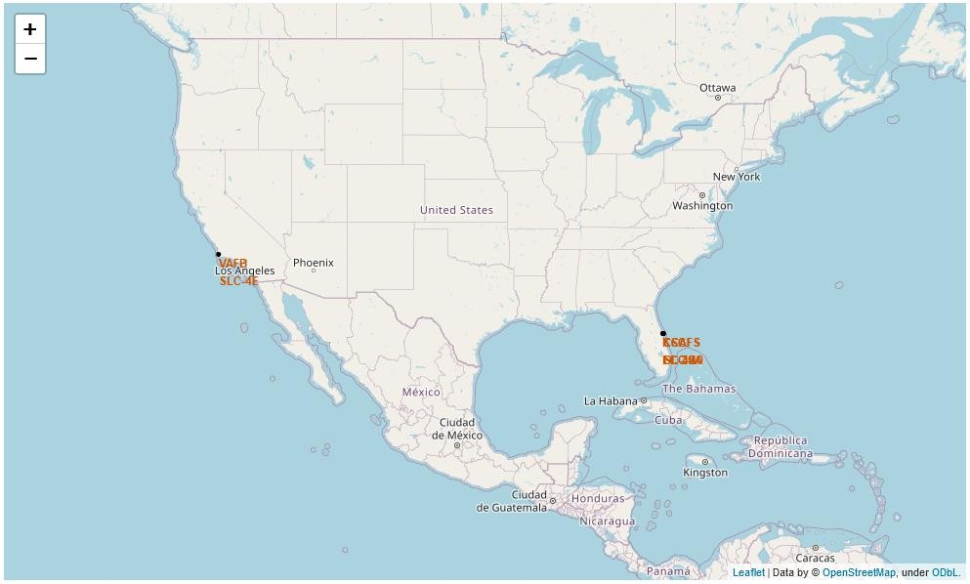
Launch Sites
Launch sites are near sea, probably by safety, but not too far from roads and
railroads.

Slide 38

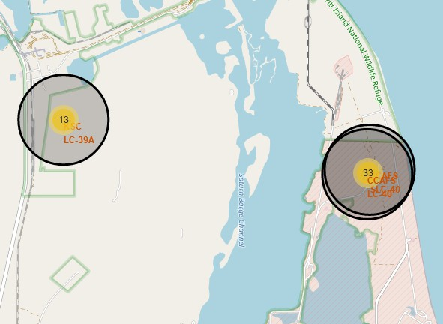
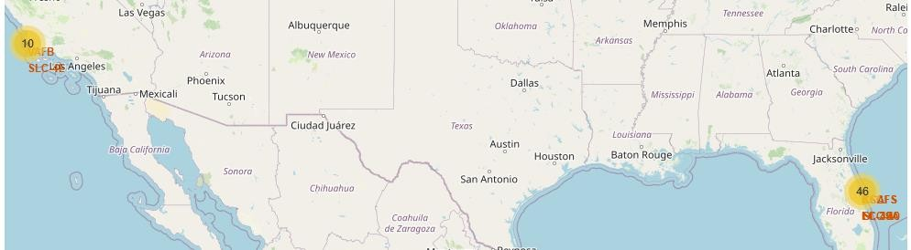

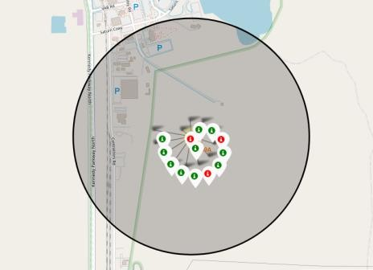
Launch Outcomes
Green markers indicate successful and red ones indicate failure.

Slide 39
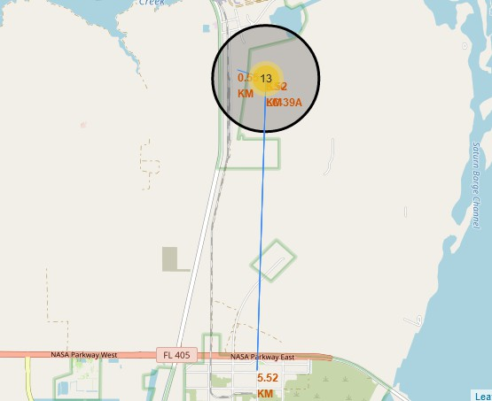
Logistics
Launch site KSC LC-39A has good logistics aspects, being near railroad and road and relatively far from inhabited areas.

Slide 40

Section 4

Slide 41
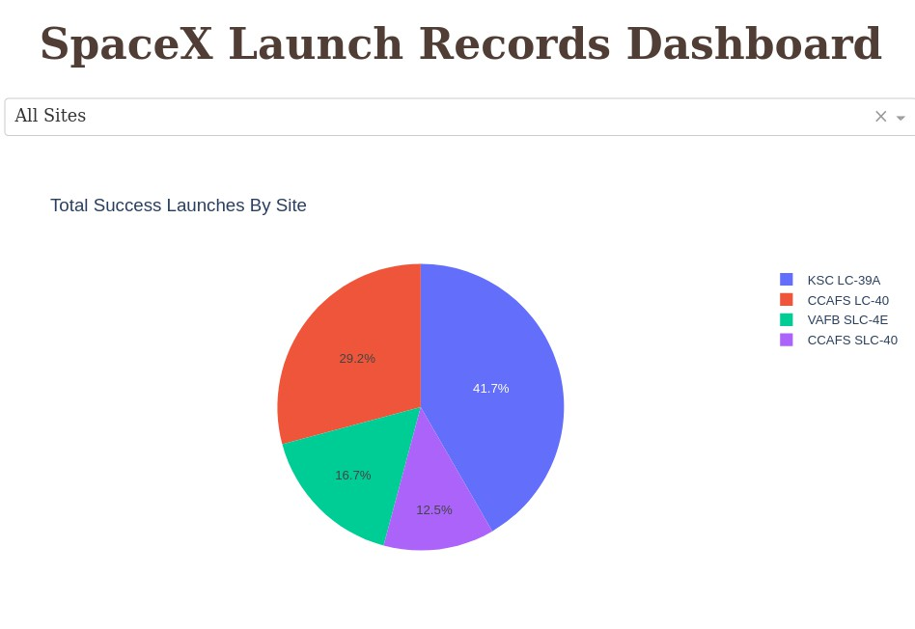
Successful Launches
The place from where launches are done seems to be a very important factor of
success of missions.

Slide 42
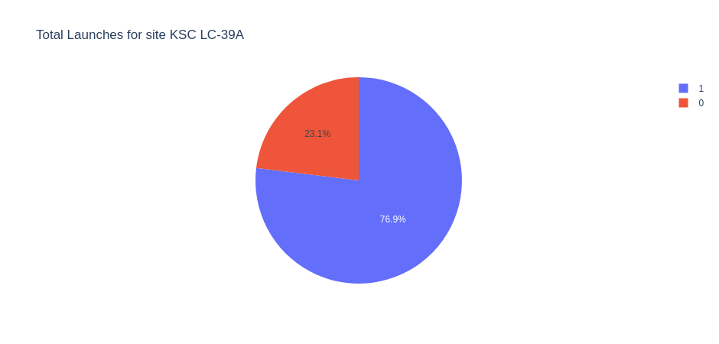
Launch Success for site KSC LC – 39A
76.9% of launches are successful in this site.

Slide 43
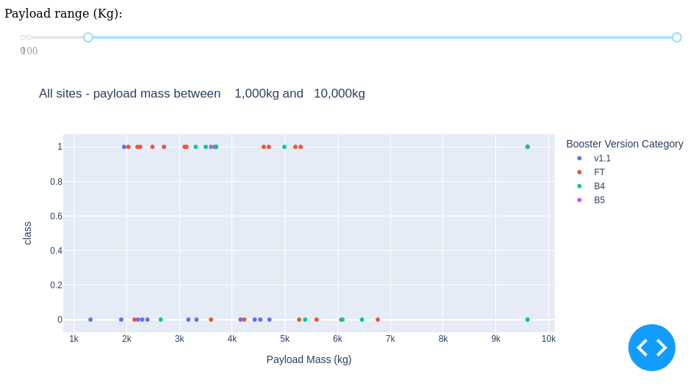
Payload vs Launch Outcome
Payloads under 6,000kg and FT boosters are the most successful combination.

Slide 44

Section 5

Slide 45
Classification Accuracy
Four classification models were tested, and their accuracies are plotted beside;
The model with the highest classification accuracy is Decision Tree Classifier, which has accuracies over than 87%.

Slide 46
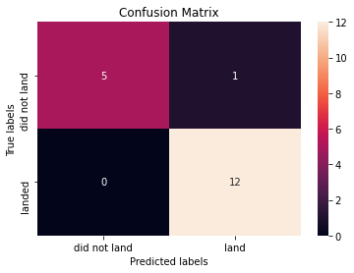
Confusion Matrix
Confusion matrix of Decision Tree Classifier proves its accuracy by showing the big
numbers of true positive and true negative compared to the false ones.

Slide 47
Conclusions
Various data sources were analyzed, leading to refined conclusions throughout the process.
KSC LC-39A is identified as the top launch site.
Launches with payloads over 7,000kg are associated with lower risk.
While most mission outcomes are successful, the success rate of landings appears to improve over time due to advancements in processes and rockets.
A Decision Tree Classifier can be utilized to predict successful landings and enhance profitability.

Slide 48
Appendix
All codes and notebooks are found in my github repo:
https://github.com/CmeDinfinity/Capstone_spaxeX

Slide 49


